Slide 1
How to Use This Template
Follow the instructions in the course to create this presentation.
Note that you will be saving this presentation as a PDF. Therefore, all the content will be on the face of the slide. Content in the notes section will not be published.
Don’t use animation as it won’t reflect in the PDF.
Add as many additional slides as you need.
Feel free to add pictures and anything that you need to enhance the presentation.

Slide 2

Tableau Capstone
31 May 2024

Slide 3

Table of Contents
Introduction
Methodology
Results
Extra Materials
Presentation Improvement
Innovation and Value Addition
Appendix
Stock ID: 47857043

Slide 4

Introduction

Slide 5

Introduction
A leading retail chain that operates globally, renowned for its diverse product offerings and commitment to customer satisfaction. In order to maintain its competitive edge and optimize business performance, the company is keen on leveraging data-driven insights to enhance sales strategies and operational efficiency.
Conduct a comprehensive analysis of the sales performance of the retail chain across different regions and time periods.

Slide 6

Methodology

Slide 7
Data Details
Data files used: sales.csv, product_hierarchy.csv, store_cities.csv, store_names.csv, city_names.csv , and product_names.csv
Data cleanup all files, checking format. Types, filling in missing data
Perform basic charts using Tableau
Advanced Visualization Using Tableau – Dashboard
Creating Engaging Stories in Tableau

Slide 8
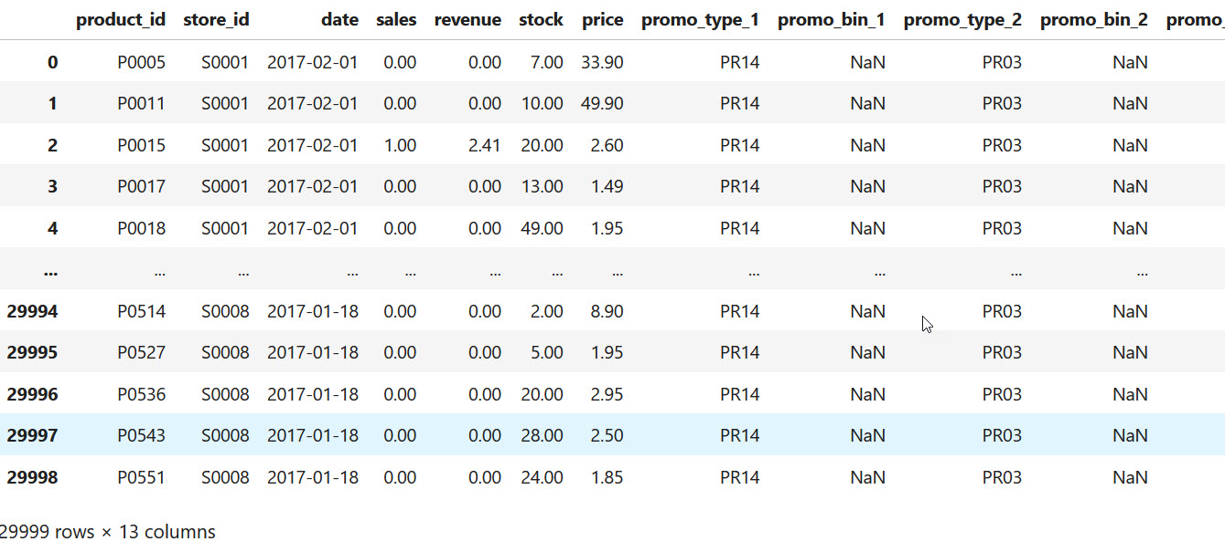
Module 1: Preparing Data and Creating Basic Visualizations

Slide 9
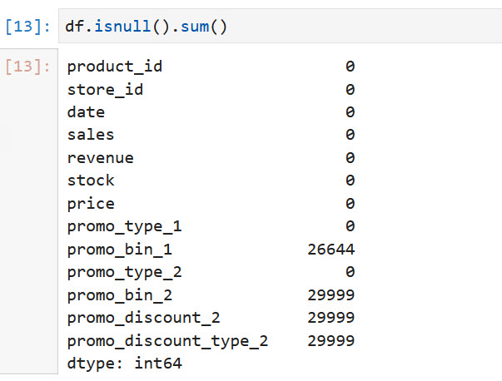
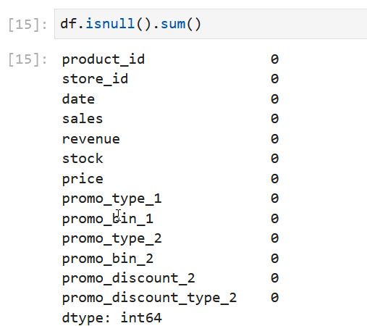
Module 1: Preparing Data and Creating Basic Visualizations

Slide 10
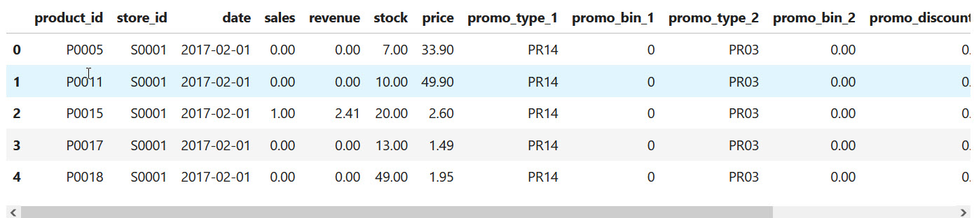
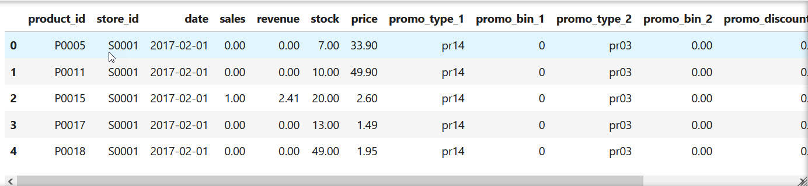
Module 1: Preparing Data and Creating Basic Visualizations

Slide 11
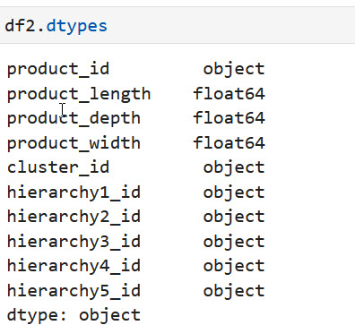
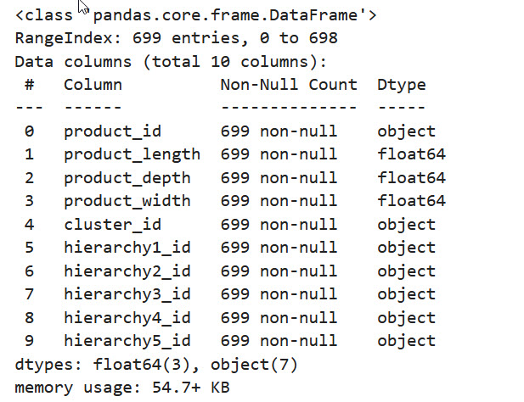
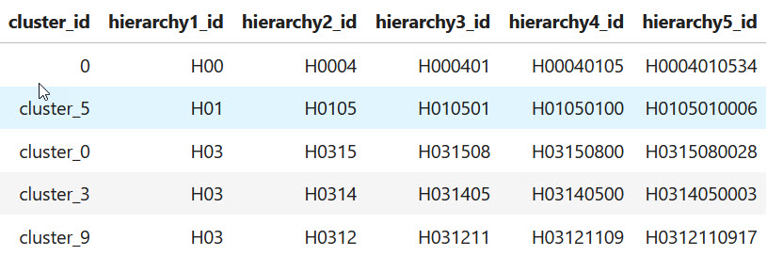
Module 1: Preparing Data and Creating Basic Visualizations

Slide 12
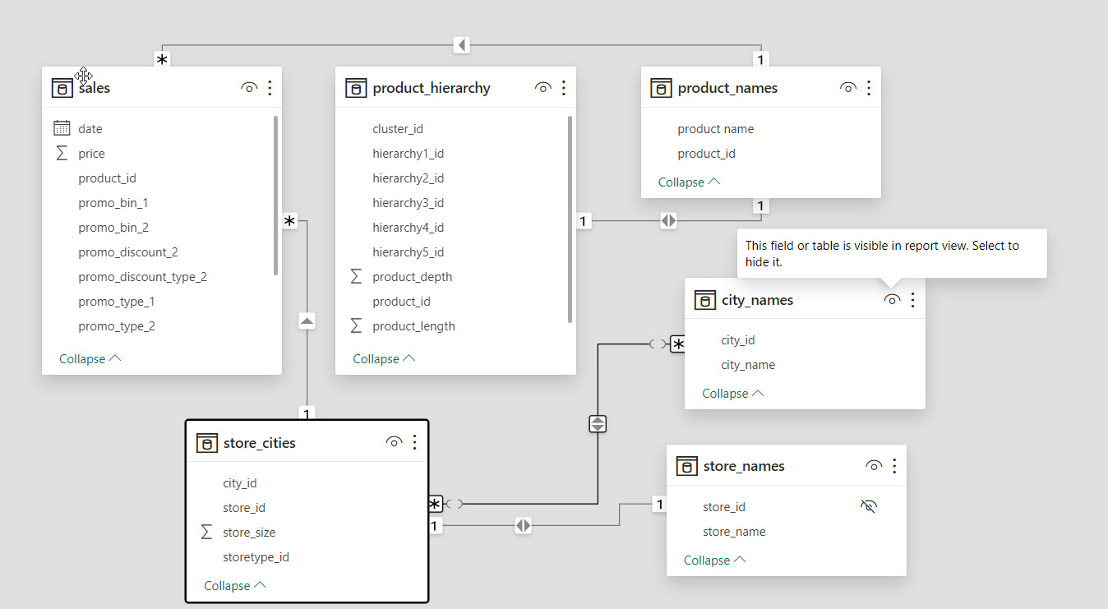
Module 1: Preparing Data and Creating Basic Visualizations

Slide 13

Results

Slide 14
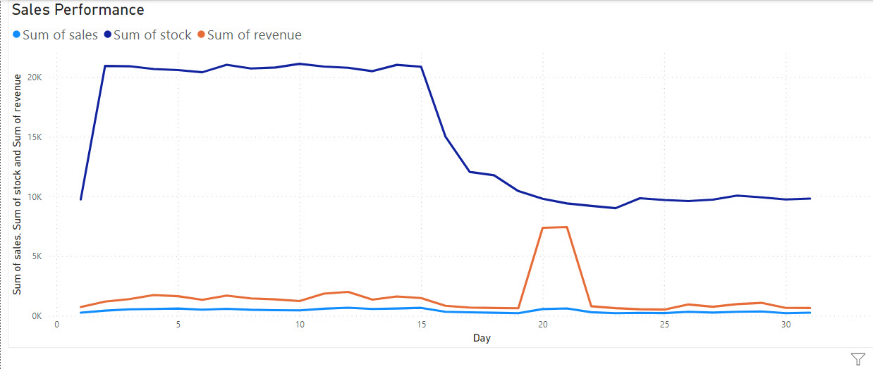
Module 2: Advanced Visualizations, Dashboards, and Stories with Tableau

Slide 15
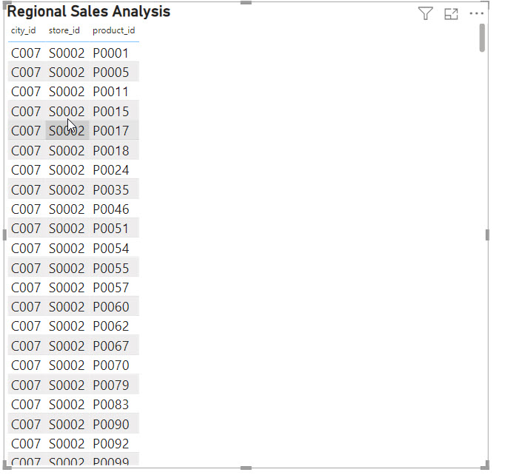
Module 2: Advanced Visualizations, Dashboards, and Stories with Tableau

Slide 16
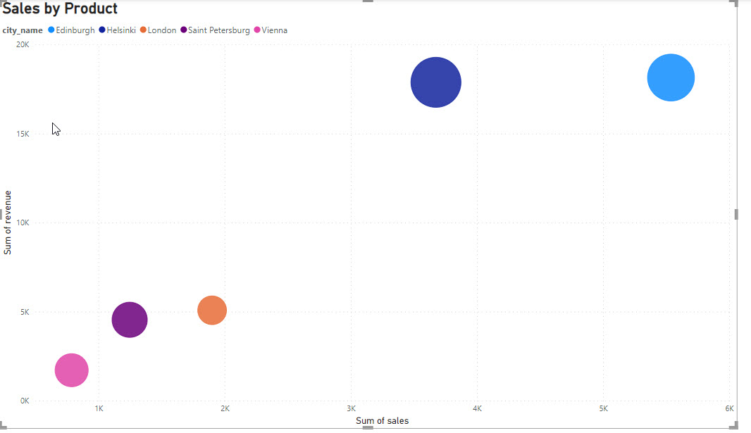
Module 2: Advanced Visualizations, Dashboards, and Stories with Tableau

Slide 17
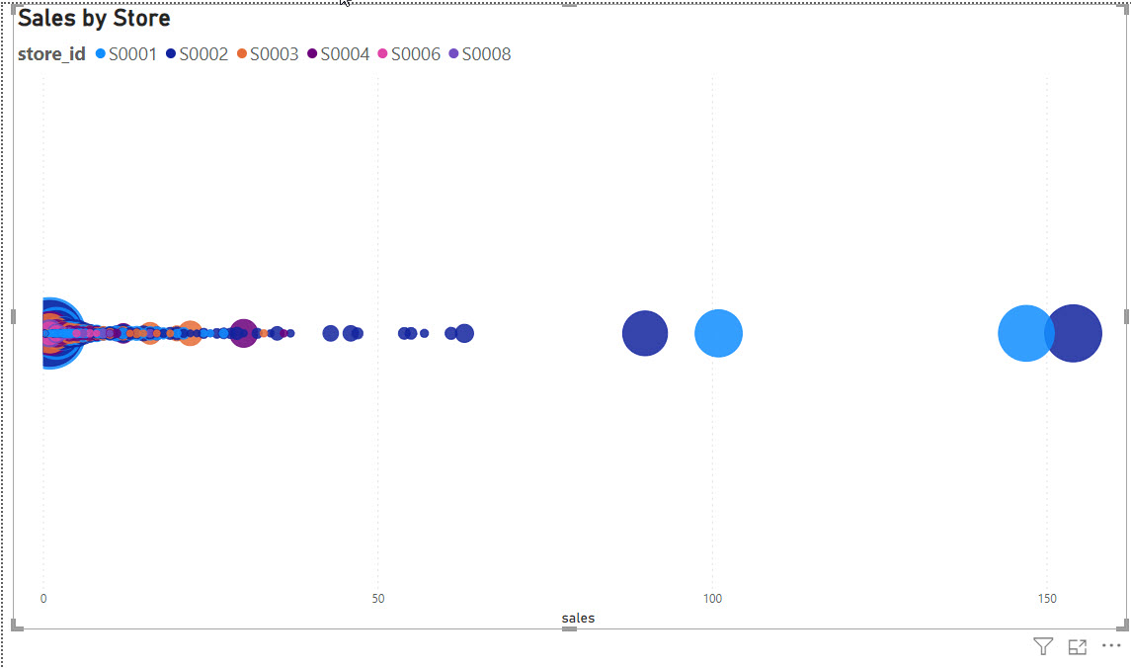
Module 2: Advanced Visualizations, Dashboards, and Stories with Tableau

Slide 18
Module 2: Advanced Visualizations, Dashboards, and Stories with Tableau
A line chart is effective for showing trends over time or across ordered categories
A bar chart is ideal for comparing discrete categories or showing distribution.
A scatter plot displays individual data points as dots on a two-dimensional plane.
A packed bubbles chart represents hierarchical data using circles of varying sizes.

Slide 19
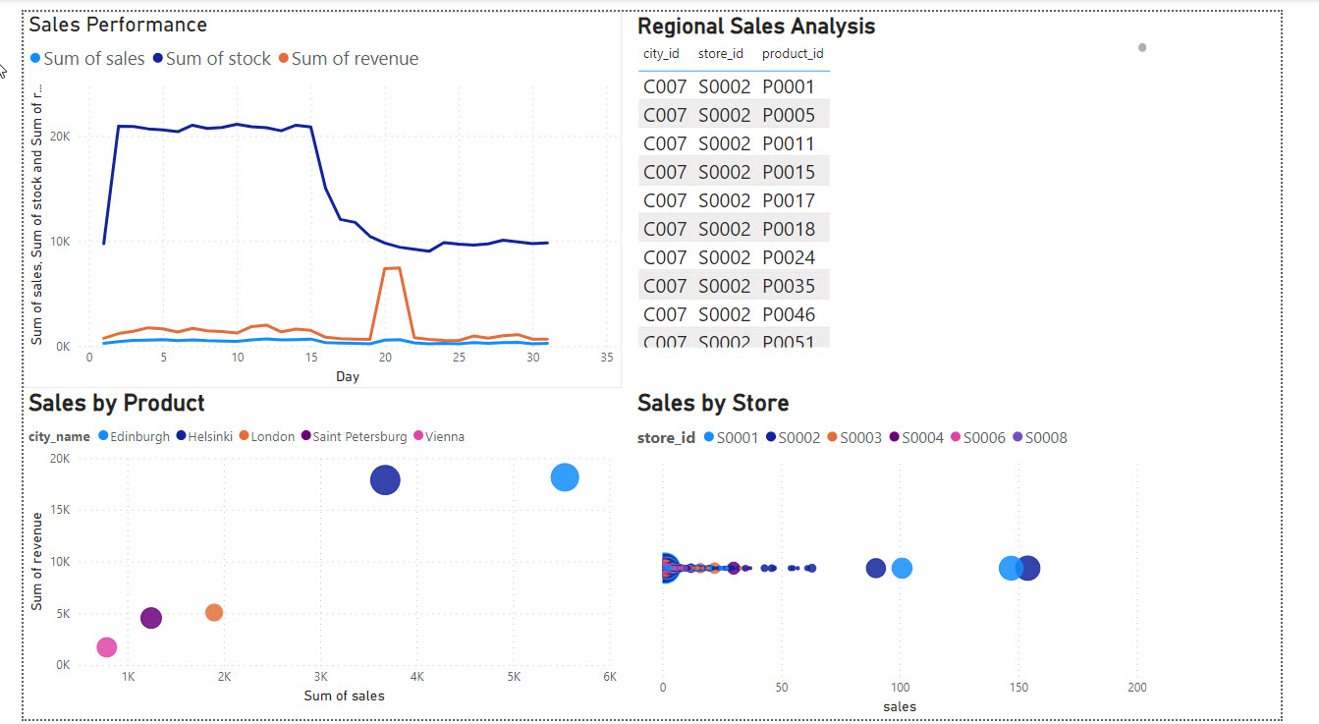
Module 2: Advanced Visualizations, Dashboards, and Stories with Tableau

Slide 20
Module 3: Tableau Capstone Project Submission and Evaluation

Slide 21

Extra materials

Slide 22
Any extra chart or worksheets
Create a chart or worksheet that segments customers based on their purchasing behavior, such as frequency of purchases, average transaction value, or product preferences. This can help identify different customer segments and tailor marketing strategies accordingly.
Develop visualizations that depict seasonal sales patterns, including peaks and troughs in sales across different regions or product categories. Understanding seasonal trends can aid in optimizing inventory management and promotional campaigns.
Incorporate data on competitor sales or market share to compare against your retail chain's performance. Visualizing this data can highlight areas where your company is excelling or where there may be opportunities for improvement.
Evaluate the effectiveness of past promotional campaigns by visualizing sales data before, during, and after promotions. This can help assess the impact of various promotional strategies on sales performance and inform future promotional planning.

Slide 23
Presentation Improvement
Prepare a concise executive summary highlighting the key findings, actionable insights, and recommendations derived from your analysis. This summary should provide a high-level overview of the sales performance analysis and its implications for the business.
Design infographics to visually represent complex data and concepts in a clear and engaging manner. Infographics can help simplify information, making it easier for stakeholders to grasp important insights at a glance.
Include case studies or success stories that highlight real-world examples of how data-driven insights have been leveraged to drive business growth or improve operational efficiency within the retail chain. These stories can add credibility to your analysis and inspire confidence in the proposed recommendations.

Slide 24
Innovation and Value Addition
Facilitate a crowdsourced data analysis session during the presentation, where audience members can contribute their observations, hypotheses, or interpretations of the sales data in real time. This collaborative approach fosters active participation and encourages diverse perspectives.
Incorporate interactive physical props or prototypes, such as miniature retail store models or product displays, to complement the data visualizations and provide a tangible representation of key insights. This multisensory approach engages multiple senses and enhances comprehension.
Integrate live data feeds into the presentation to demonstrate real-time sales performance and trends. This dynamic approach keeps the audience engaged and allows them to witness the immediate impact of data-driven insights on business operations.

Slide 25

Conclusion

Slide 26
Summary

Slide 27

Appendix

Slide 28
Appendix #
Include any relevant additional charts, worksheets, or tables that you may have created during the analysis phase

